Slide 1
Introduction to R Workshop
Amrom Obstfeld
July 16, 2020

Slide 2
Course Introduction

Slide 3
Goals and Objectives
Advocate for the use of R as a means of improving reproducibility in clinical data analysis
Demonstrate how R is used to perform analyses of laboratory operational data
Establish a basis of understanding in the 'tidy' approach to data analysis within the framework of R

Slide 4
July 16 2020 | Session | Instructor
1:00 pm - 1:30 pm | Instructor Introductions, Introduction to technology | Amrom Obstfeld
1:30 pm - 2:15 pm | Introduction to R and RStudio | Joe Rudolf
2:30 pm - 3:15 pm | Reproducible Reporting | Patrick Mathias
3:30 pm - 5:00 pm | Data Visualization | Stephan Kadauke
July 17 2020
1:00 pm - 2:30 pm | Data Transformation | Amrom Obstfeld
2:45 pm - 4:15 pm | Statistical Analysis | Dan Herman
4:30 pm - 5:00 pm | Advanced Reporting | Patrick Mathias

Slide 5
Who are we?

Slide 6
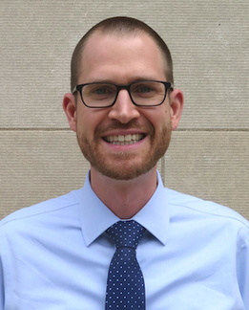
Joseph Rudolf
Assistant Professor, Department of Pathology, University of Utah Medical School
Medical Director, Automated Core Laboratory, ARUP Laboratories
Notes:
Joseph Rudolf, MD is the medical director for the automated core laboratory at ARUP Laboratories in Salt Lake City, Utah. He earned his medical degree (2012) from the University of Washington School of Medicine in Seattle, Washington. He completed his residency training in Clinical Pathology (2015) and fellowship in Clinical Informatics (2017) at the Massachusetts General Hospital in Boston, Massachusetts. His clinical and research interests focus on the intersection of informatics and clinical operations including clinical decision support, utilization management, and reporting and analytics. He is also passionate about clinical process improvement and initiatives to support quality and safety.

Slide 7
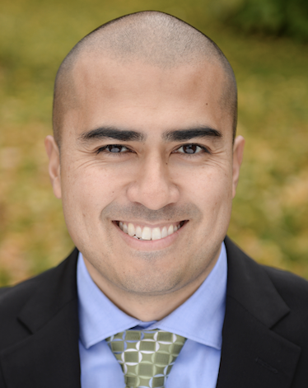
Patrick Mathias
Assistant Professor, Department of Laboratory Medicine
University of Washington School of Medicine
Associate Medical Director, Laboratory Medicine Informatics
Notes:
Patrick Mathias, MD, PhD, is the Associate Medical Director of the Informatics Division in the Department of Laboratory Medicine at the University of Washington School of Medicine. He completed his MD and PhD in Bioengineering at the University of Illinois in Urbana-Champaign, followed by a clinical pathology residency and a clinical informatics fellowship at the University of Washington School of Medicine. His interests include developing data science and analytics as a core competency to improve clinical lab operations and laboratory stewardship, and applying clinical informatics approaches to mitigate laboratory-associated diagnostic errors. He is interested in developing and improving programming and data science education across all levels of pathology practice.

Slide 8
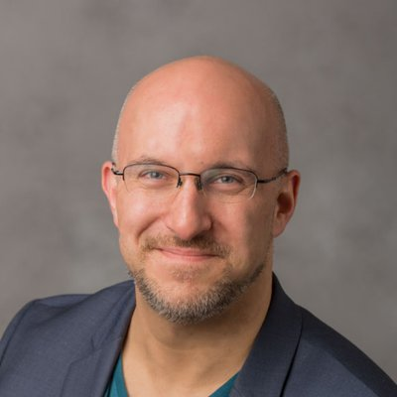
Stephan Kadauke
Assistant Professor of Clinical Pathology and Laboratory Medicine
University of Pennsylvania Perelman School of Medicine
Assistant Director of the Cell and Gene Therapy Laboratory
Children's Hospital of Philadelphia
Notes:
Stephan Kadauke, MD, PhD is an Assistant Professor of Pathology and Lab Medicine at the Children’s Hospital of Philadelphia where he is the Assistant Director of the Cell and Gene Therapy Lab. He leads the Cell and Gene Therapy DataOps group which builds and deploys predictive models and other data products for the care of children who receive bone marrow transplants and other cell therapies.

Slide 9
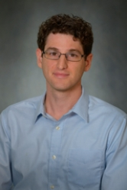
Daniel Herman
Assistant Professor of Pathology and Laboratory Medicine
University of Pennsylvania Perelman School of Medicine
Director, Endocrinology Laboratory
Hospital of the University of Pennsylvania
Notes:
Daniel S. Herman
Assistant Professor of Pathology and Laboratory Medicine, University of Pennsylvania; Director of Endocrinology, Hospital of the University of Pennsylvania
PHILADELPHIA, PA | daniel.herman2@pennmedicine.upenn.edu
Daniel Herman practices clinical pathology at the University of Pennsylvania, where he directs the Endocrinology laboratory at the Hospital of the University of Pennsylvania. He completed his MD and PhD degrees at Harvard Medical School and trained in Clinical Pathology at the University of Washington. His current clinical practice, in addition to clinical chemistry, includes leading informatics projects to make better use of existing laboratory data in the form of live operational dashboards, test utilization reports, and identification of missing patient diagnoses.
His research group has been developing EHR-based methods to improve population health screening, focused recently on improving population hypertension management by identifying patients with undiagnosed primary aldosteronism. He is also interested in the intersection of pathology and policy and currently serves as College of American Pathology State Issue Advisor for Pennsylvania.

Slide 10
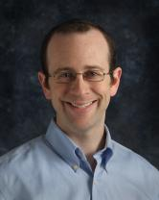
Amrom Obstfeld
Assistant Professor of Clinical Pathology and Laboratory Medicine
University of Pennsylvania Perelman School of Medicine
Director of Pathology Informatics
Children's Hospital of Philadelphia
Notes:
Amrom Obstfeld MD, PhD, is the Medical Director of the Division of Pathology Informatics directs the Hematology and Coagulation Laboratories at Children’s Hospital of Philadelphia. In this role Amrom leads the development of analytic tools to aid in laboratory quality management, administration, and operation, supports the deployment of new IS infrastructure in pathology and interfaces with other groups throughout the hospital on informatics initiatives. Dr. Obstfeld plays a major role in designing and implementing educational experiences for pathology trainees and faculty at the University of Pennsylvania within the areas of clinical and pathology informatics.

Slide 11
Workshop Workflow

Slide 12
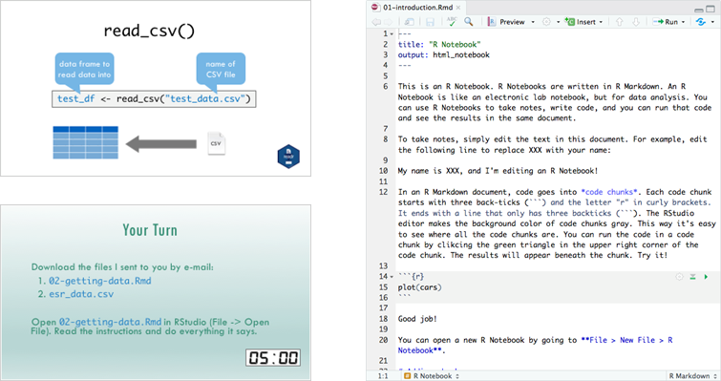
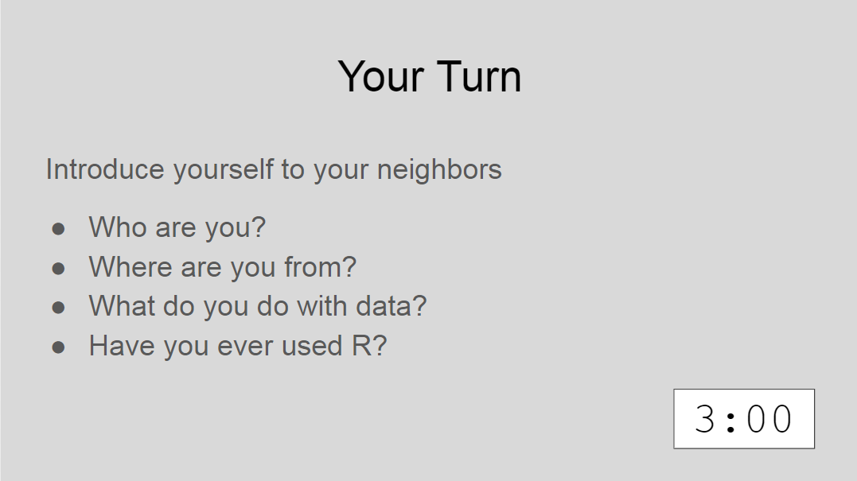
Lectures

Slide 13

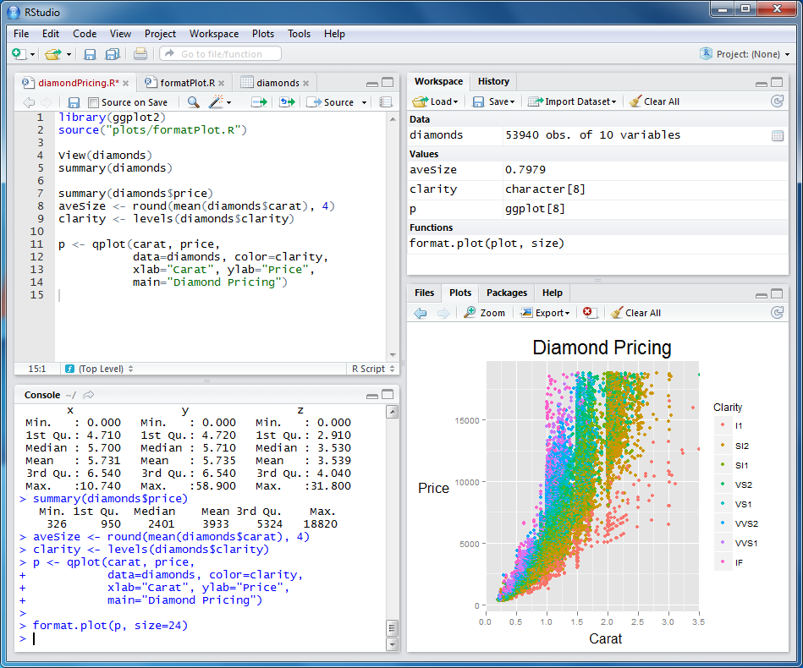
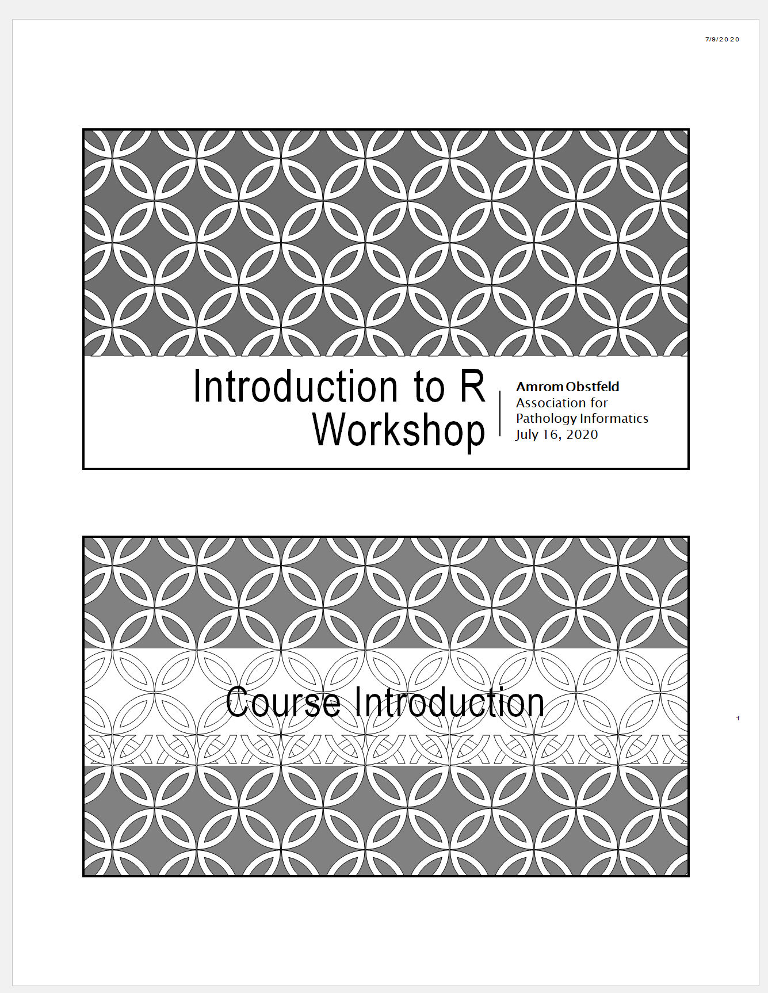
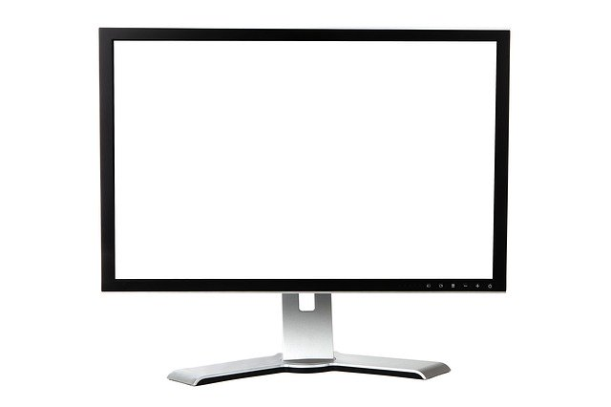

Your Setup
1
2
Notes:
These are the resources that you should have access to during this workshop.
Ideally you have zoom open on one of your monitors, you have a second monitor in which you will be opening up the Rstudio cloud application, we haven’t gotten to that yet so don’t worry about that yet
And third you should have the PDF of the course book available to you at your desk.
We of course understand that not everyone has two monitors, not anyone has the capacity to print out a few hundred pages of the course book, so if you have a tablet and can use Zoom on it, we encourage you to open up the zoom there and at least have the PDF of the course book open on your computer as well.

Slide 14
Workshop Coursebook
Print out of all slides
Appendix
Cheat sheets
Useful resources

Slide 15
Using Zoom
Participants muted
Chat window
Non-verbal feedback
Breakout sessions
Notes:
Let’s talk a little bit about how we'll be using zoom in this workshop.
During the sessions everyone will be muted other than the instructor. That doesn’t mean that there won’t be opportunities for engagement, we want to make sure that this is an interactive workshop and not an experience that only has communication going in one direction
We will be accessing a chat window in Zoom we will also be using some nonverbal feedback modalities and we'll have breakout sessions during which we'll be doing exercises together in an interactive way.
So let’s try out some of these features of zoom that you may not be familiar with →→

Slide 16
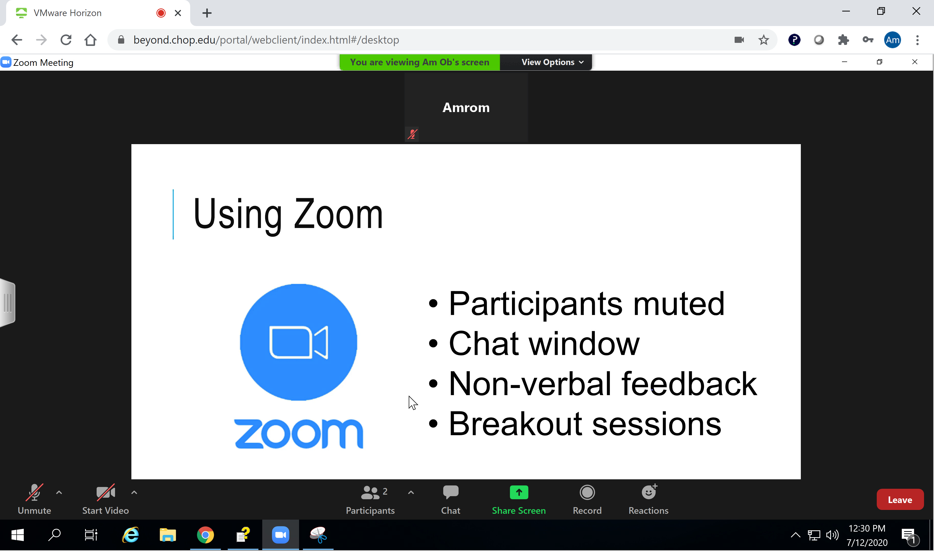
Notes:
This is more or less what you should be seeing on your screen.
At the bottom of the Zoom window you’ll notice a tab called Participants and a tab called Chat
Click on both of those tabs and you should get a pop-up window that has a list of all of the participants that are in the workshop and a Pop up Chat window.
If those pop ups appear docked on the right side of your Zoom window then you’re in good shape. If they appear as free-floating windows you’re going to need to tell zoom to dock it over on the right. The best way to do this is by taking yourself out of Full screen view. At the top of your zoom window you should see something that says view options click there and then click exit full screen that should trigger zoom to dock your participants went out after the right. Worst comes to worst, you can always manually drag those windows to the side yourself.
Ill give everyone a minute to work through that.

Slide 17
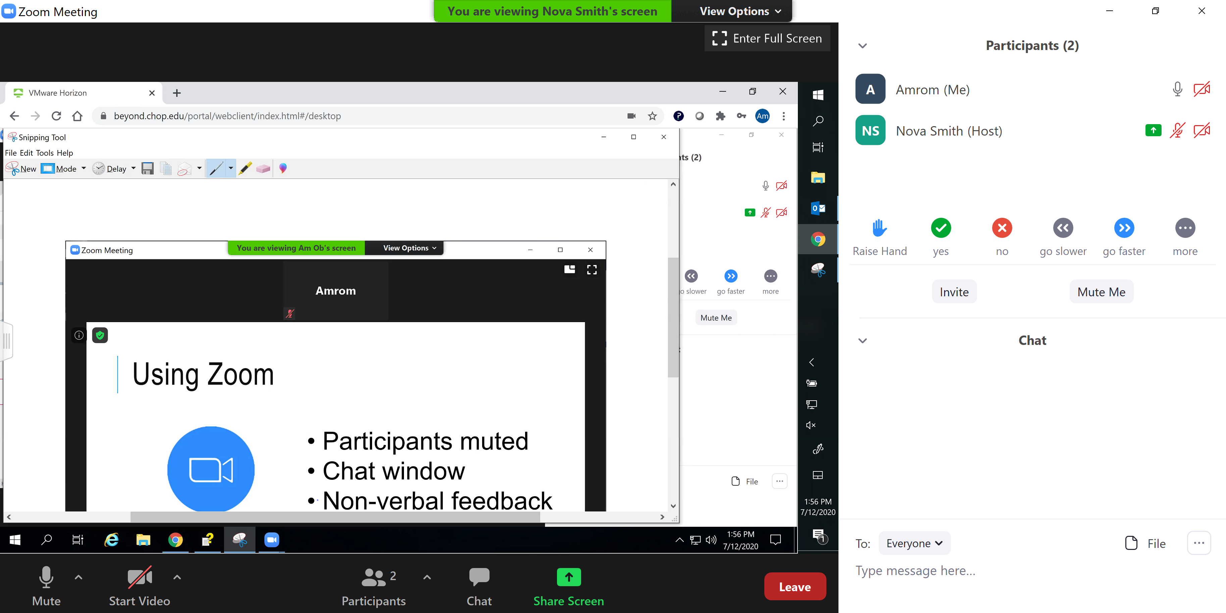
Notes:
If you were successful you should now have a participants and chat window off to the right.
Don’t get confused here this is my side bar and this is your side bar.
You'll notice on the bottom of the Participants Pane that there are several icons, Raise Hand, Yes, No, and so on.
If you have the participant in pane open and have access to these icons do us a favor and press the YES icon. You’ll see that a yes appears right next to your name. Let me give you guys a minutes to get that yes button clicked.
---
OK looks like you guys were able to do it, As the host I can clear all these icons out like this. Every so often we'll ask you for some non verbal feedback to make sure we're all together.
---
Occasionally we'll want to elicit a bit more than yes or no, that's where the chat window comes in. Let’s see if you can use the chat window. By default these chats will be going to everyone, you do have the option to send direct messages. A word of warning don't try sending a DM to the presenter since they won't be able to respond, so by default just leave this set to everyone. Why don’t we all type in to the chat window where in the world we're connecting from.

Slide 18
Getting Help
During presentation – Raise hand, instructor will DM
Break out sessions – Instructor available, unmuted
Notes:
During the workshop sooner or later you’re likely going to need some help.
If you find yourself having a question or needing assistance during a presentation what we’re asking you to do is to go over to the participants window and click the raise your hand icon there will be one or more instructors assigned during each session to handle questions from the participants. The instructor will send you a direct message and at that point you can work through the issues together sending code went back-and-forth without having those messages appear for everyone in the workshop.
As I mentioned earlier we will be utilizing breakout sessions intermittently for certain exercises. Each one of those breakout sessions will have an instructor in the room with you so you’ll be able to verbally communicate with one of us and get some help.
There may be issues that are just too challenging to handle in the context of a virtual workshop. If that does occur we’re going to ask you to make a note of the issue, try to keep with the workshop, and hopefully we can find a way to take it off line.

Slide 19
Who are you?
Notes:
So, now that you've learned a bit about us and how this is all going to work, let's find out a little bit about you
I mentioned that we'd be conducting certain exercises called Your Turns in a Zoom feature called breakout rooms. Breakout rooms will have about 7 or 8 participants and one of us presenters facilitate. In breakout rooms you will be unmuted and able to present your own desktop. This will enable us to see exactly what you're doing and give assistance as needed. But also we hope that these can serve as a way to get some collaborative coding and really engage with each other.
So let's get the ball rolling with our first Your Turn breakout room
→

Slide 20

Your Turn
Introduce yourself to your breakout roommates
Who are you?
Where are you from?
Why are you here?
Have you ever used R?
Notes:
Nova will send us all into breakout rooms. You may need to manually click the join break out room button. Once you do so you will have a new Zoom window with just the participants of your breakout room. Once you're there feel free to share who you are, where you are in training or what your position is in your organization, and what you hope to get out of this course.
After a few minutes Nova will call us back together and we'll finish up this intro session.

Slide 21
Final Tips
The best way to learn to code is by doing
Practice is key!
Notes:
And just some final words before we begin, no matter what you're learning but particularly coding, the best way to learn is by doing:
Find a project, make a goal for yourself, push yourself to use R, it's OK to lean on some excel, we all due when we're starting out, but try to get that activation energy to get your hands typing code. We would not be teaching this course if we didn't strongly believe that R is accessible to all of you. So keep practicing and you'll get there.
With that let's get started with the workshop. Up next Joe will provide us with the basics of R and get us up and running with Rstudio Cloud.

